Slide 1
Location Data and machine learning use case
Food Trucks: Location, Location, Location
Shane Allua
Capstone Final Project

Slide 2
Introduction
With the rise of food trucks, owners / chefs must do their research to determine the best location for operating their food truck. Some experts venture to say location is even more important than the menu.
Food truck nation continues to thrive in part as a result of a society in search of instant gratification and time constraints. Food trucks offer diverse food and offer people opportunity to try new food.
An advantage of the food truck is the ability to roam; however, understanding the food truck scene in New Orleans will be important to determining which neighborhood is the best location to attract eager customers.
The purpose of the analysis was to determine which neighborhood would be a top candidate to place a food truck.

Slide 3
Methodology
Data included a list of neighborhoods in New Orleans along with their geographical coordinates (https://en.wikipedia.org/wiki/Neighborhoods_in_New_Orleans, 2019).
Location data were explored using FourSquare API. These data include venue types within a 1000m radius of the neighborhoods. The number of venues for each venue category was analyzed to determine the average number of venues per neighborhood.

Slide 4
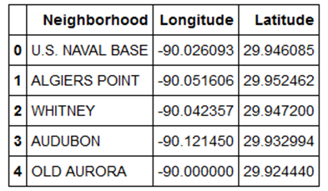
Methodology - data
Using Jupyter Notebooks, the wikipedia page was scraped using BeautifulSoup to obtain the neighborhood, latitude and longitude in the Latitude and Longitude of Neighborhoods table.
The data were transferred into a pandas data frame like the one shown in Table 1.
Table 1. Pandas data frame

Slide 5
Methodology – Exploratory Analysis
A map of New Orleans was generated and explored using the folium library package, showing the location of the 72 neighborhoods. The number of venues returned by Foursquare API was limited to 100 within a 1,000m radius.
One-hot encoding was used to assign a 0/1 to indicate the presence or absence of each venue category for each neighborhood. The rows are grouped by neighborhood to obtain the mean frequency of occurrences for each category.
An unsupervised learning method, K-Means clustering, was used to assign each data point to one of the K groups based on the similarity of the features. For this analysis, the primary feature of focus was frequency of occurrence of food trucks.

Slide 6
Results
A K-Means cluster analysis was run to group neighborhood in New Orleans, LA based on their similarity of frequency of food trucks.
The analysis with varying values of K, where the final model selected was K = 5. Based on the frequency of occurrence for food truck, cluster 2 and 4 have a small food truck presence whereas cluster 3 and 1 have a larger frequency. Cluster 0 does not have a food truck presence. See Figure 1 (next slide).

Slide 7
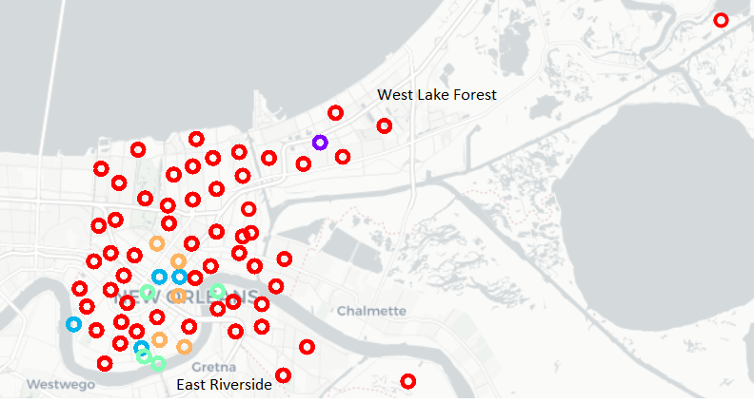
Figure 1. Clustering of Neighborhoods in New Orleans based on Food Truck Presence
West Lake Forest had the
highest occurrence of food
trucks at 7% followed by
East Riverside at 4%.
A few of the more well-known
neighborhoods in New Orleans,
such as The French Quarter and
City Park, did not have a food
truck presence.

Slide 8
conclusion
Based on the analysis, I would recommend East Riverside as a good location to park a food truck. It has a small presence of other food trucks, which indicates that food truck enthusiasts may frequent this neighborhood.
However, it may be important to bring a new flavor to the neighborhood. Further research of each of the clusters is warranted to understand competing venues, demographics, safety of neighborhoods, and other factors that contribute to the success of a food truck business.

